Slide 1
International Trade, Currency Risk Management and the Outlook for the Pound
Helping companies understand & navigate FX volatility
This presentation is not financial advice and should not be relied upon for investment or other purposes

Slide 2
George Vessey
FX & Macro Strategist, UK Western Union Business Solutions

Slide 3
Agenda
Economic outlook – Recovery expectations
Market developments – Overview of asset class performance
Currency volatility & forecasts – GBP/USD and GBP/EUR
Risk Management – Risk Score, Risk Appetite & Strategy

Slide 4
Key macroeconomic trends to watch
MACRO INSIGHT
1
2
3
Supply chain disruptions
Monetary policy & FX
Geopolitical tensions
Demand from the reopening
Record low interest rates
US-China struggle for dominance
Supply-side bottlenecks
Rising yields as a risk factor
Populism rising around the world
Costs and delivery times rising
Tapering economic stimulus
Brexit & NI strains
Source: Western Union Business Solutions - June 2021

Slide 5
The largest shock since WWII
MACRO INSIGHT
Lockdowns halted economic activity
But market panic was short-lived
Drawdown (days, LHS)
China
Drawdown return (%, RHS)
Recovery (days, LHS)
Real GDP growth Q2 2020 (% q/q)
US
UK
Lockdown stringency index (Q2 average of daily data)
Chart sources: Refinitiv Datastream Western Union Business Solutions - June 2021

Slide 6
Global growth prospects are improving
MACRO INSIGHT
UK expecting strongest rebound since 1941
But vaccine rates still matter
Vaccine-powered economic recovery could boost world output to pre-pandemic levels by mid-2021.
UK growth expected to outpace other advanced economies including the US.
The faster the vaccination rate, the sooner sectors like hospitality/retail can recover.
US, UK most likely to beat 2021 GDP forecasts if vaccine roll-outs outpace new COVID variants.
2021 projection (%, y/y growth)
Country | % population vaccinated at least once | Lockdown Stringency Index (0-100)
US | 50.5% | 52
UK | 58.3% | 63
FR | 38.9% | 55
DE | 45.1% | 75
CA | 58.9% | 75
AU | 15.6% | 45
2022 projection (%, y/y growth)
Chart sources: OECD Databank, ourworldindata, Western Union Business Solutions - June 2021

Slide 7
Key developments across global financial markets
MARKET INSIGHT
Pound is second best performer of G8 currencies
Sterling is one of best performing currencies in 2021 – driven by the vaccine trade.
Market sentiment suggests higher inflation is expected but higher yields not so much.
Evidenced by the continued strong performance of cyclical and tech stocks.
Oil prices are circa 35% stronger year-to-date.
Demand for inflation assets
Assets typically weakened by higher inflation are still rising
These currencies have declined versus GBP
Chart sources: Refinitiv Datastream, Western Union Business Solutions –June 2021

Slide 8
Soaring commodity prices fuelling inflation
MARKET INSIGHT
Commodity prices reflect strong import demand
Commodity Research Bureau Index (CRB)
Shortage of supply due to restrictions and returning workers, as well as a surge in demand following national lockdowns.
This reflects optimism about a global rebound from the pandemic as vaccine roll-outs gather steam.
Demand for goods across major markets is surging at rates not seen in over 10 years – this is reflected in HIS Markit’s April PMI tracking manufacturers’ new orders.
Agricultural commodities
E.g. Corn, wheat
@ record highs
+108% Vs. Mar 2020
Pandemic hits markets
Industrial metals
E.g. Copper, aluminium
@ 10-year high
+209% Vs. Mar 2020
Precious metals
E.g. Gold, silver
Near 7-year high
+110% Vs. Mar 2020
Chart sources: Refinitiv Datastream, Western Union Business Solutions –June 2021

Slide 9
But how much is speculative?
MARKET INSIGHT
Copper prices outpacing China’s industry
Some leading indicators suggest that part of the commodity price rally is sentiment- and not demand-driven.
Investors have increasingly shifted capital into commodities as a kind of hedge against the rise in prices.
Regardless of the long-term trend in commodity prices, the short-term trend is higher similar to inflation.
144% increase
Chart sources: Refinitiv Datastream, Western Union Business Solutions –June 2021

Slide 10
Rising yields leading to rising currency values
MARKET INSIGHT
Positive correlation between yields and currencies
If a foreign yield rises against UK yields, that foreign currency should appreciate against the pound.
Inflation is expected to soar in the short term, mounting pressure on central banks to reduce stimulus.
If central banks hint at tightening, as seen recently in Hungary and Poland - yields should rise.
If central banks stand pat, like in the US, yields should fall and weigh on respective currency.
Chart sources: Refinitiv Datastream,, Western Union Business Solutions –June 2021. Yields = government 10-year bond yield.

Slide 11
Vaccination rates also influence currency developments
MACRO INSIGHT
7-day vaccinations (per million inhabitants)
A rapid and successful vaccine rollout should fast-track easing of economic restrictions.
The peak of daily vaccinations in the US in April was also the beginning of the turnaround of the US dollar.
Sterling strengthened earlier this year thanks to fast UK vaccine rollout whilst the euro was left lagging.
Chart sources: Refinitiv Datastream, Western Union Business Solutions –June 2021

Slide 12
Volatility data suggests major turning point ahead
CURRENCY INSIGHT
Currency volatility index near 12-month low
Coiled currencies primed for breakouts?
Chart sources: Refinitiv Datastream, Western Union Business Solutions –June 2021

Slide 13
GBP/USD near 3-year high amid lower volatility
CURRENCY INSIGHT
GBP-USD exchange rate volatility & forecasts
$1.42 3-year high
Daily price changes of >1%-3%
+10%
5-year average rate
Daily price changes of ~<1%
$1.14
35-year low
Chart sources: Refinitiv, Western Union Business Solutions – June - 2021
Notes:
Less vol – good opp to make hedging decisions

Slide 14
Sterling positively positioned versus most major peers
CURRENCY INSIGHT
GBP is >10% above 2-year average Vs USD & JPY
Currency pair spot price | Spot | 2021 performance | % Δ 6-month average | % Δ 2-year average | % Δ 5-year average
GBP-EUR | 1.16 | 4.07% | 2.66% | 2.68% | 1.05%
GBP-USD | 1.42 | 3.56% | 4.10% | 10.70% | 8.36%
GBP-CAD | 1.71 | -1.58% | -0.93% | 0.35% | -0.53%
GBP-AUD | 1.83 | 2.70% | 1.47% | -1.25% | 1.56%
GBP-JPY | 154.82 | 8.90% | 6.93% | 12.09% | 8.37%
Risk-correlated GBP has benefited from reduced risk aversion & rapid UK vaccine rollout.
Safe haven JPY has been heavily sold off as a result of improved risk appetite and a dovish BOJ.
Cyclical currencies like CAD have outperformed amid hawkish BOC and rising commodity prices.
Chart sources: Refinitiv Datastream, Western Union Business Solutions –June 7 2021
Notes:
Thin grey line vertical

Slide 15
Rise of GBP/USD in May for first time since 2009
CURRENCY INSIGHT
GBP/USD historical May performance
In the month of May, investors often take profit on April gains usually achieved by corporate dividend repatriation of overseas income.
Since 2010, GBP/USD had, on average, fallen 2% in May.
But May 2021 saw an end to this decade-long trend.
GBP/USD climbed circa 2.8% - a clear sign of the pound’s attractiveness.
GBP/USD monthly % change (May)
First rise in May in over a decade
Chart sources: Refinitiv Datastream, Western Union Business Solutions –June 2021
Notes:
Thin grey line vertical

Slide 16
Market scenarios | Sterling/US Dollar
CURRENCY INSIGHT
Forecast Tool – exchange rate outcomes
Forecast Scenarios – upside/downside risks
Scenario 1 – High
UK’s vaccine advantage leads to faster & stronger economic recovery. Global growth momentum outpaces US growth and the Bank of England hint at raising interest rates as inflation pressures rise. Post-Brexit trade deals benefit UK’s dominant services sector, which rebounds sharply during recovery phase, boosting demand for UK assets.
Scenario 2 – Base Case
Uneven recovery as new variants of Covid continue emerging and infections rise globally and in the UK – leading to delayed easing of lockdown measures. UK vaccine pace remains on track though, buoying demand for UK assets.
Scenario 3 – Low
Extended national lockdowns to curb Covid-19 infection rates and new virus variants. Uncertainties regarding global economic outlook persist. US yields continue to rally as inflation expectations rise amidst a faster US economic recovery and expected tightening of monetary policy.

Slide 17
Market scenarios | Sterling/Euro
CURRENCY INSIGHT
Forecast Tool – exchange rate outcomes
Forecast Scenarios – upside/downside risks
Scenario 1 – High
UK’s vaccine advantage leads to a faster & stronger economic recovery, and a tightening of monetary policy by the Bank of England. Post-Brexit trade deals benefit UK’s dominant services sector, which rebounds sharply during recovery phase, boosting demand for UK assets.
Scenario 2 – Base Case
Uneven recovery as new variants of Covid continue emerging and infections rise across Europe – leading to delayed unlocks. UK vaccine pace remains on track though, providing confidence in speedy economic rebound relative to European peers.
Scenario 3 – Low
Extended national lockdowns to curb Covid-19 infection rate. Uncertainties regarding global economic outlook persist. Future UK-EU trade in financial services remains unclear and relations sour. New trade deals fail to make up for the GDP variance lost as a result of Brexit.

Slide 18
Alex Lawson
Head of Hedging, UK & Europe Western Union Business Solutions

Slide 19
What can volatility tell us about hedging?
CURRENCY VOLATILITY
Historical Volatility vs Implied Volatility
Historical volatility is defined as “the annualised standard deviation of past price movements.” – e.g. how much the rate fluctuated on a day-to-day basis over a one-year period.
Implied volatility isn’t based on historical pricing data on the underlying currency. Instead, it is a dynamic figure that changes based on activity in the options marketplace. It’s what the marketplace is “implying” the volatility of the rate will be in the future, based on price changes in an option.
Event risk causes option prices to move up or down based on demand, but bear in mind, it’s only the options’ time value that is changing. This is because of changes in the perceived potential range of future rate movement.
Usually, when implied volatility increases, the price of options will increase as well, assuming all other things remain constant.
Essentially, this reflects the fact that uncertainty has increased and therefore the value of protection, with the ability to participate in favourable movements is greater.
But, you don’t need to use options for implied volatility to be relevant to your hedging decision…

Slide 20
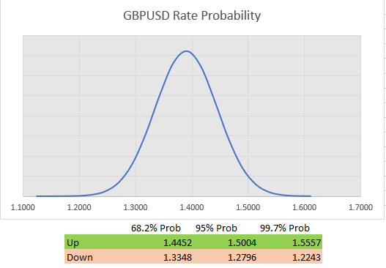
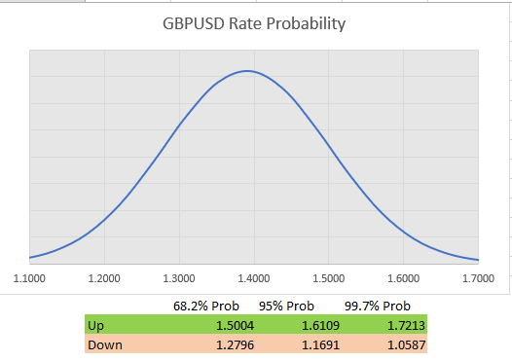
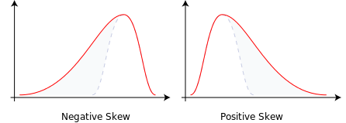
What can implied volatility tell us?
CURRENCY VOLATILITY
Implied volatility can tell us the value of one standard deviation assuming normal distribution.
This in turn gives a probability of a rate being seen in a given period.
This probability has significant bearing on options pricing, but should also play a part in the budgeting/ planning process as well as hedging decision making.
The longer the timeframe, the greater your potential risk
The higher the implied volatility, the greater your potential risk
Remember, though, markets are not rational

Slide 21
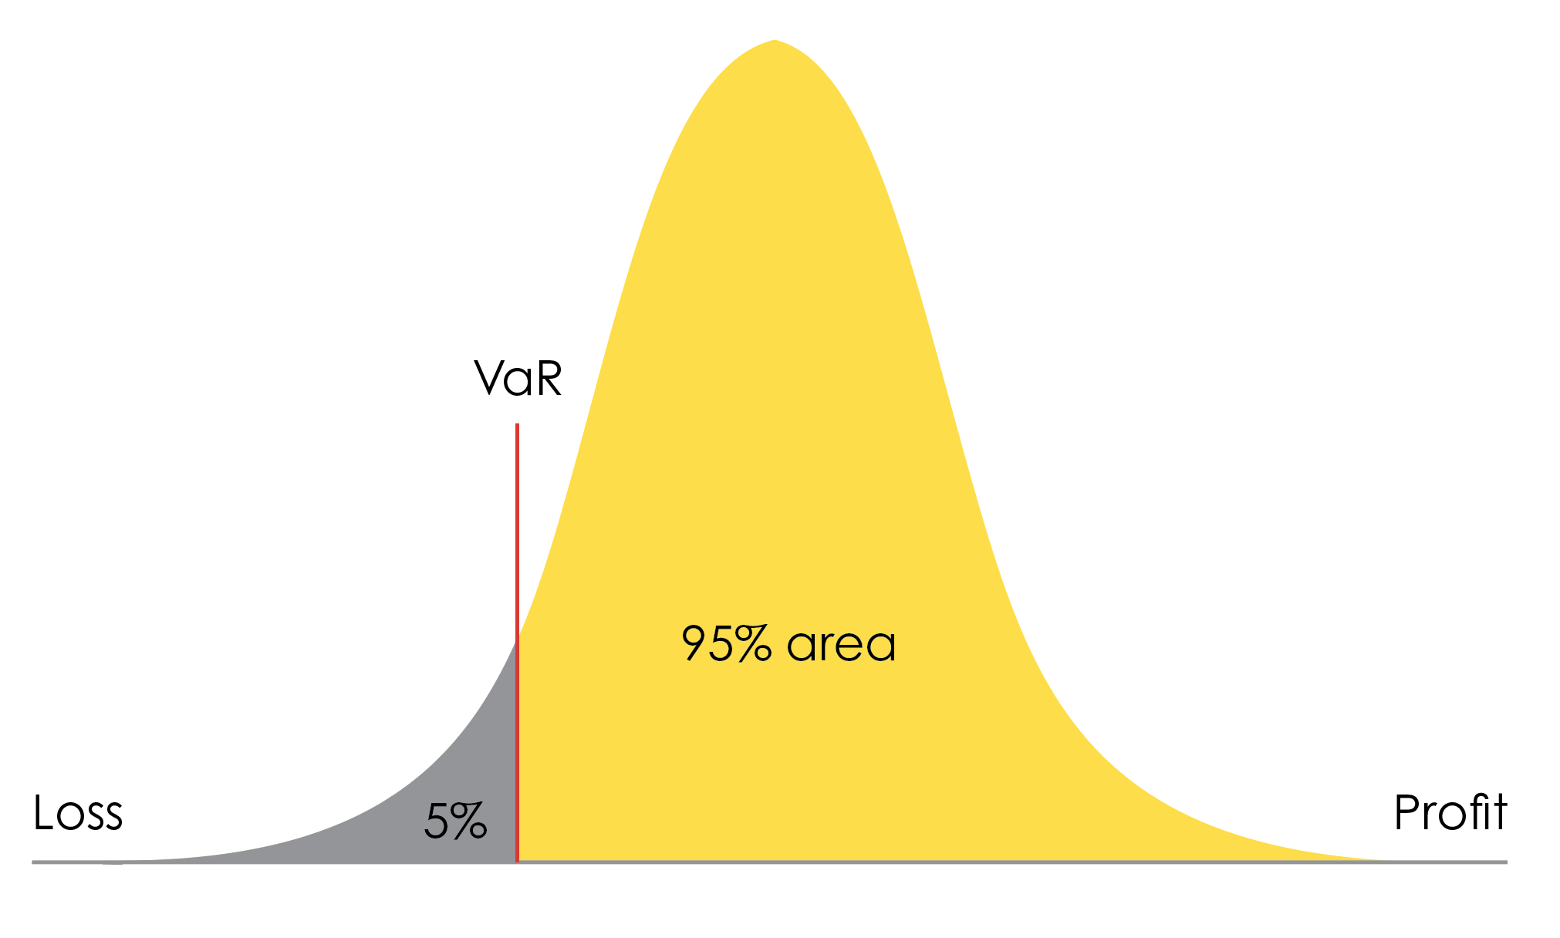
Value at Risk?
CURRENCY VOLATILITY
Value at Risk (VaR) is a statistic that measures and quantifies the level of financial risk. Most commonly it is used to determine the potential for loss and the probability of occurrence for the defined loss.
There are limitations on the usefulness of VaR in this respect. For example the VaR measure during a period of low volatility will quickly become irrelevant should volatility increase, to say nothing of the assumption on normal distribution.
Losses can also exceed the VaR amount, often by a considerable amount when significant events occur.
However, VaR can play a part in assessing and managing risk on an ongoing basis, particularly when utilised along with other inputs.

Slide 22
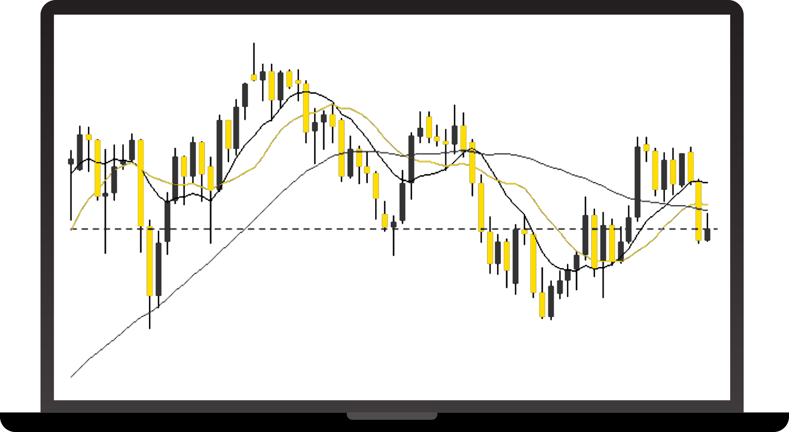
4 Step Cycle
SMARTER HEDGING
1. Review your exposure
2. Define your business goals
3. Decide on your Hedging Strategy
4. Execute your Currency Plan

Slide 23
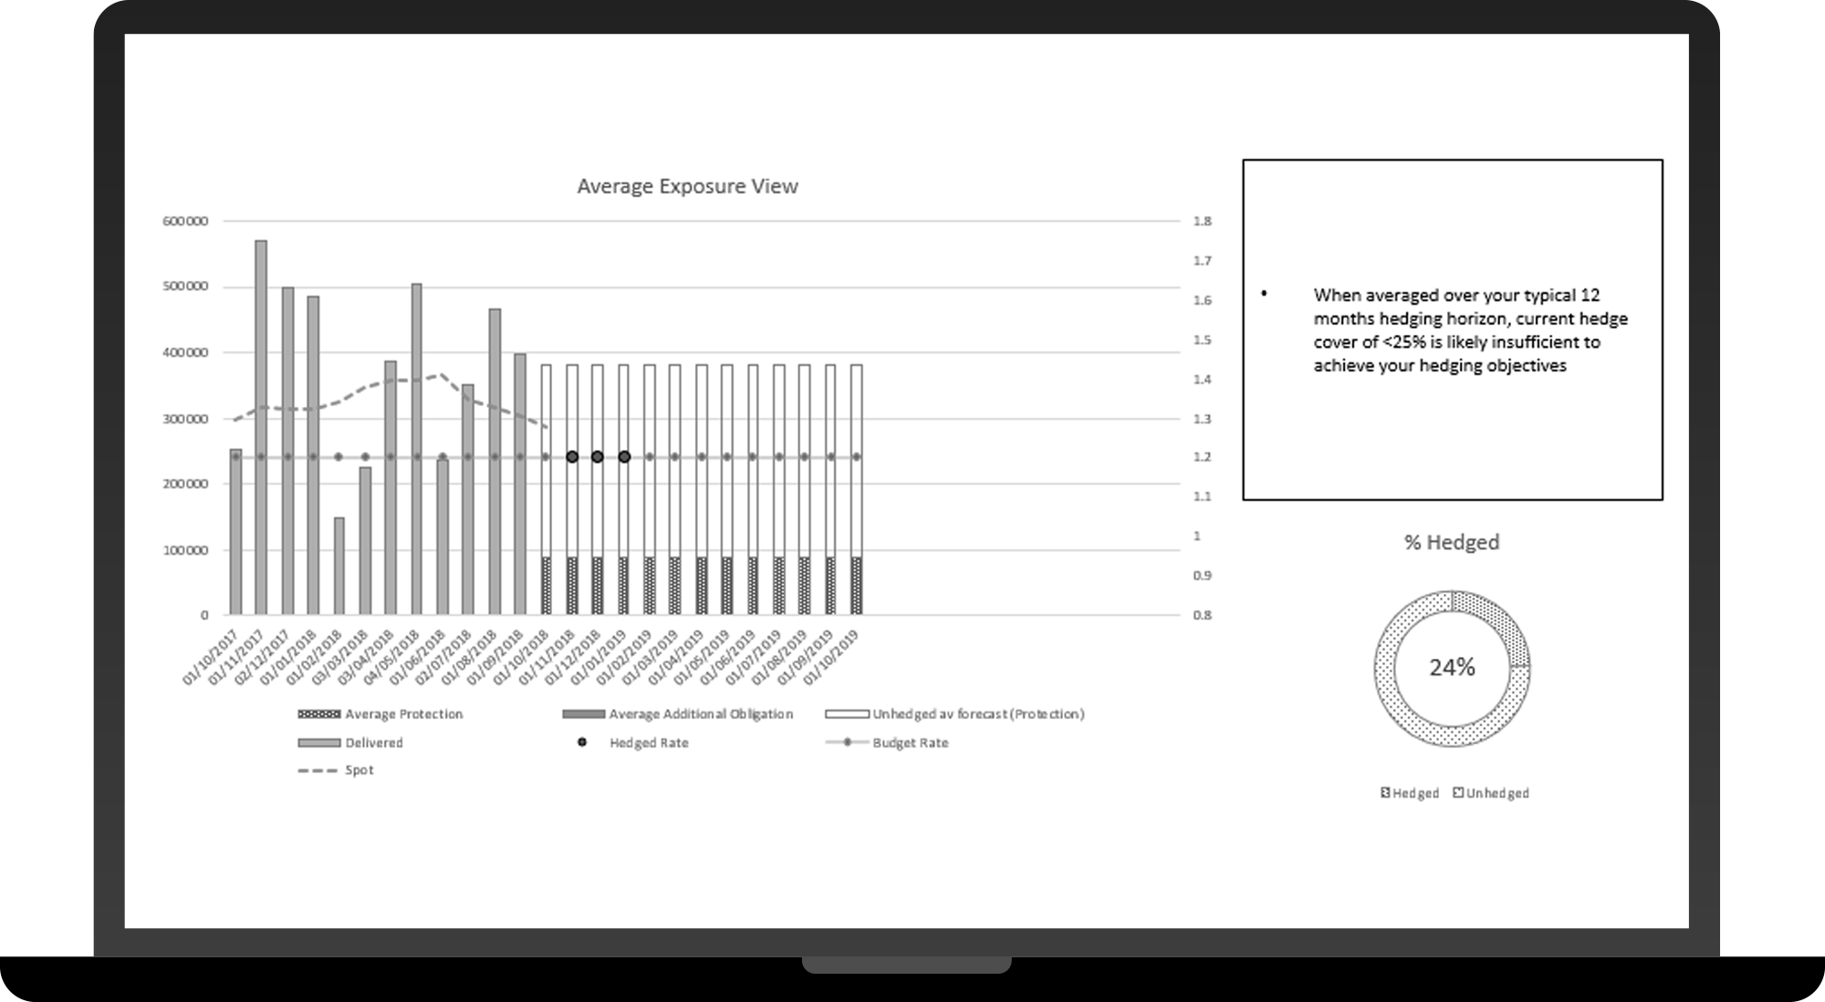
4 Step Cycle
SMARTER HEDGING
Step 1: Review your currency exposure
Gain clear visibility of your past/future exposures
Identify currency risk
Simulate volatility and its impact on your profits

Slide 24
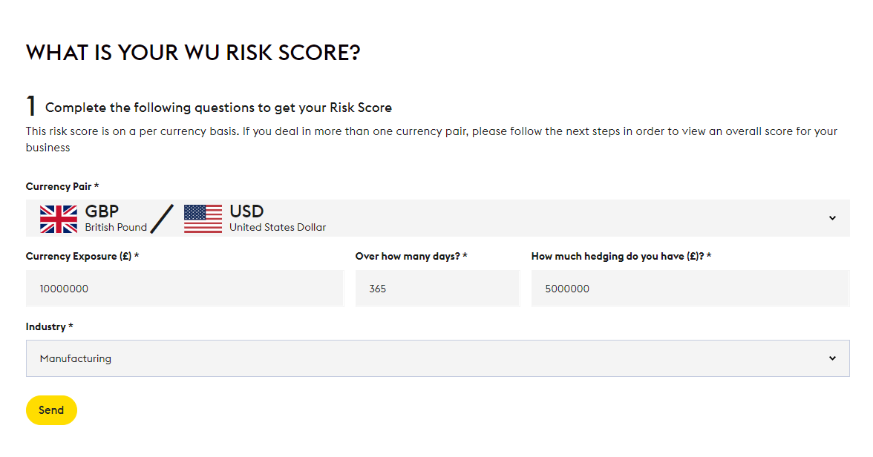
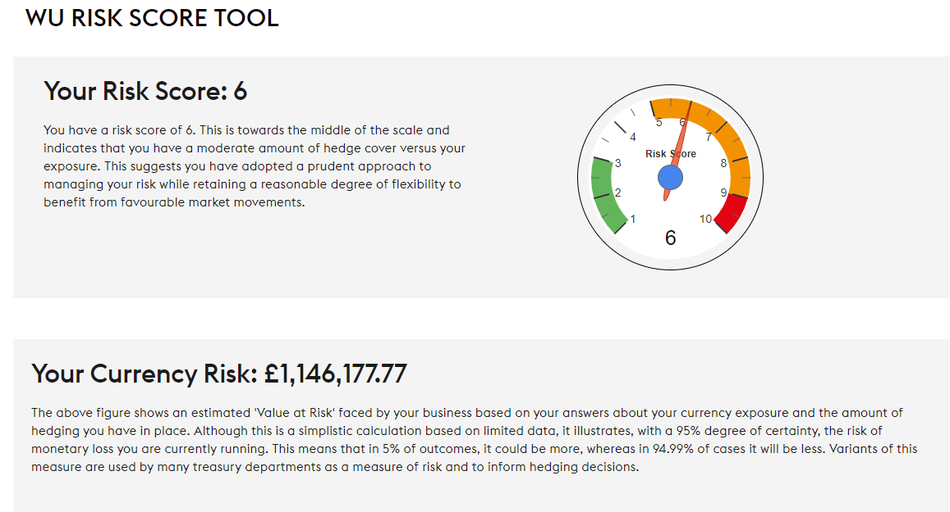
What is your Risk Score?
SMARTER HEDGING
The Western Union Risk Score takes some basic data and gives you a Value at Risk figure.
More importantly it distils this down to a score from 1 to 10.
As this takes into account volatility, you can see how your currency risk changes, even if your exposure and levels of hedging do not.

Slide 25
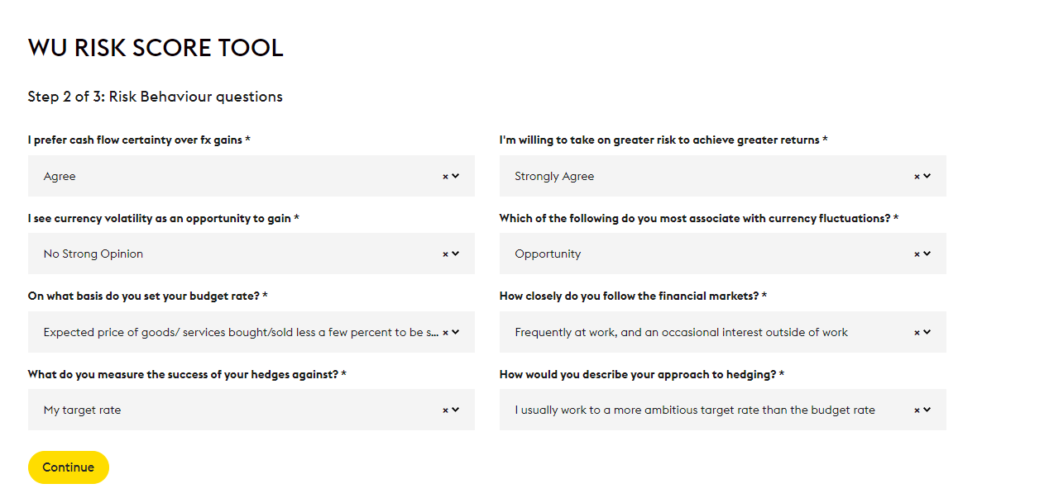
How does that compare to your Risk Appetite?
SMARTER HEDGING
Stage 2 assesses your Risk Appetite by asking a few questions on how you approach hedging and how you measure success.
The idea is to gain a point of reference against which you can interpret your Risk Score.

Slide 26
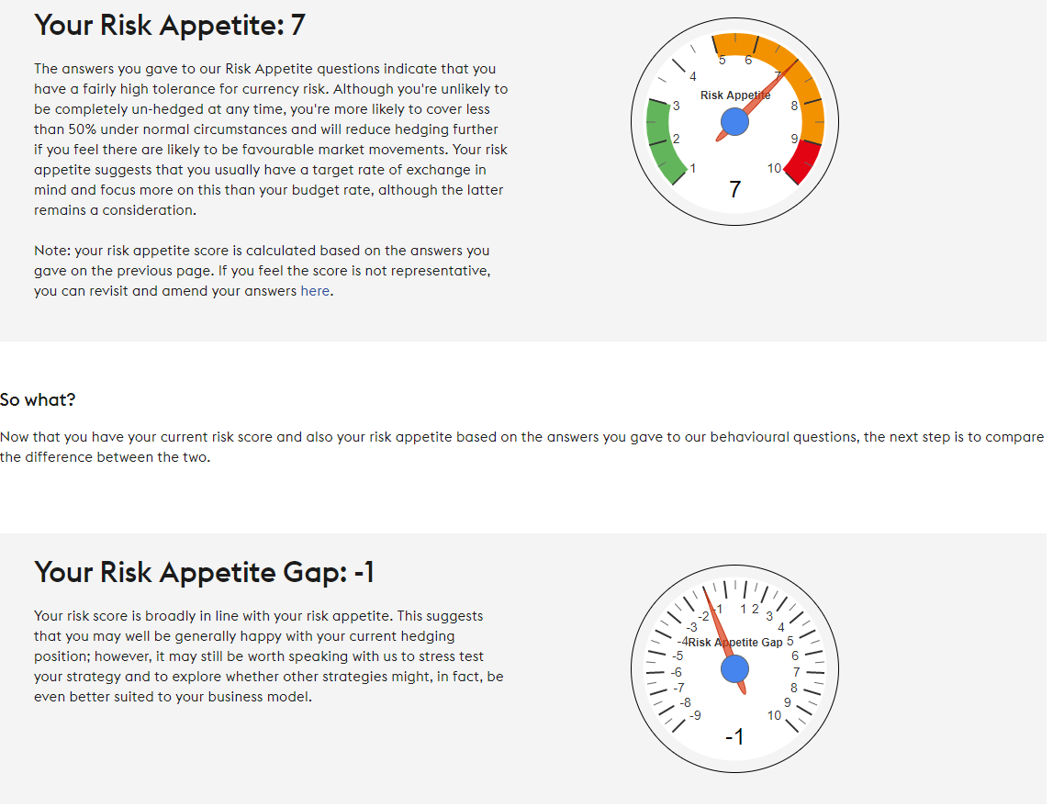
How can you use this to make smarter hedging decisions?
SMARTER HEDGING
Your Risk Appetite Score is also rated from 1 to 10.
The idea being to highlight if there are discrepancies and, if so, whether there are underlying reasons for this.
Once you have a Risk Appetite Score that you are satisfied with, you can start to build this into a hedge strategy to make smarter hedging decisions.

Slide 27
Visibility - Certainty - Efficiency
SMARTER HEDGING
1
2
3
Visibility
Certainty
Efficiency
Understand your risk
Reduce risk now
OR
Plan your actions under potential outcomes
Use available resources/ tools to aid decision making
Be ready to act when the time is right

Slide 28
Questions?
Please use the Q&A feature to submit your questions

Slide 29
Are you trading internationally?
Contact us:
E: partners@westernunion.com
T: 0800 096 0172
https://business.westernunion.com/en-gb/

Slide 30
Western Union Business Solutions (WUBS) has based the opinions expressed in this communication on information generally available to the public. Western Union Business Solutions makes no warranty concerning the accuracy of this information and specifically disclaims any liability whatsoever for any loss arising from trading decisions based on the opinions expressed and information contained in this communication. Such information and opinions are for general information purposes only and are not intended to present advice with respect to matters reviewed and commented upon.
This communication is not directed to, or intended for distribution to or use by, any person or entity who is a citizen or resident of or located in any locality, state, country or other jurisdiction where such distribution, publication, availability or use would be contrary to law or regulation or which would subject WUBS or its affiliates to any registration or licensing requirement within such jurisdiction.
This communication has been prepared solely for informational purposes and does not in any way create any binding obligations on either party. Relations between you and WUBS shall be governed by the applicable terms and conditions provided to you before you undertake any transaction with WUBS. No representations, warranties or conditions of any kind, express or implied, are made in this communication.
© 2021 Western Union Holdings Inc. All rights reserved.
ASIA PACIFIC
Australia
In Australia, Western Union Business Solutions is a division of The Western Union Company. In Australia, Western Union Business Solutions (Australia) Pty Limited ABN 24 150 129 749 and AFSL 404092 (“WUBS”) is the issuer of the financial products (if any) referred to in this communication.
A Product Disclosure Statement is available for each of the financial products that WUBS issues (if any) and can be obtained by visiting our compliance and legal web page: https://business.westernunion.com/en-au/About/Compliance-Legal. Unless we expressly state otherwise any information given by WUBS in relation to financial products will be factual information only and does not take account of your financial situation, objectives or needs. Because of this, before you act on it (including making any decision and/or trading) you should consider its appropriateness having regard to your own objectives, financial situations and/or needs.
Before you decide to acquire a financial product from WUBS you should read and consider the relevant product disclosure statement.
Hong Kong
In Hong Kong, Western Union Business Solutions is a division of The Western Union Company. Services in Hong Kong are provided by Western Union Business Solutions (Hong Kong) Limited (company number 1474270 and CE number BGY438) (“WUBS”).
WUBS is a licensed money service operator under the Anti-Money Laundering and Counter-Terrorist Financing (Financial Institutions) Ordinance (Chapter 615, the Laws of Hong Kong). WUBS is also licensed by the Securities and Futures Commission in Hong Kong to conduct Type 3 (leveraged foreign exchange trading) regulated activity.
Risk Disclosure Statements
1. The risk of loss in leveraged foreign exchange trading can be substantial. You may sustain losses in excess of your initial margin funds. Placing contingent orders, such as “stop loss” or “stop limit” orders will not necessarily limit losses to the intended amounts. Market conditions may make it impossible to execute such orders. You may be called upon at short notice to deposit additional margin funds. If the required funds are not provided within the prescribed time, your position may be liquidated. You will remain liable for any resulting deficit in your account. You should therefore carefully consider whether such trading is suitable in light of your own financial position and investment objectives.
2. Client assets received or held by WUBS or a WUBS group company outside Hong Kong are subject to the applicable laws and regulations of the relevant overseas jurisdiction which may be different from the Securities and Futures Ordinance (Cap. 571) and the rules made thereunder. Consequently, such client assets may not enjoy the same protection as that conferred on client assets received or held in Hong Kong.
New Zealand
Western Union Business Solutions is a division of The Western Union Company. In New Zealand, Western Union Business Solutions (Australia) Pty Ltd, NZ branch (company number 3527631 and FSP 168204) (“WUBS”) is the issuer of the financial products (if any) referred to in this communication. A Product Disclosure Statement is available for each of the financial products that WUBS issues and can be obtained by visiting http://business.westernunion.co.nz/about/compliance/.
This communication is not intended to provide advice and does not take account of your financial situation, objectives and/or needs. Because of this, before you act on it (including making any decisions and/or trading) you should consider its appropriateness having regard to your own objectives, financial situation and/or needs. WUBS recommends that you seek personalised (personal) financial advice from an authorised financial adviser.
Singapore
In Singapore, Western Union Business Solutions is a division of The Western Union Company. Depending on the nature and scope of the services, services in Singapore are provided by Western Union Business Solutions (Singapore) Pte Ltd (Licence No. PS20200438) (“WUBS Singapore”) and/or WUBS Financial Services (Singapore) Pte Ltd (Licence No. CMS 100116) (“WUBS FS Singapore”) (collectively referred to as “WUBS”).
NORTH AMERICA
Canada
In Canada, Western Union Business Solutions is a division of The Western Union Company. Services in Canada are provided by Custom House ULC, a company within the Western Union Business Solutions division.
USA
In USA, Western Union Business Solutions is a business unit of The Western Union Company. Services in the US are provided by Western Union Business Solutions (USA), LLC (NMLS ID: 907333; MA MT license #: FT0041) (referred to as “WUBS” or “Western Union Business Solutions”). For a complete listing of US state licensing, visit http://business.westernunion.com/about/notices/. For additional information about Western Union Business Solutions USA, LLC visit http://business.westernunion.com/About/Compliance-Legal.
EUROPE
Austria
In Austria Western Union Business Solutions is a business unit of the Western Union Company and provides services in Austria through Western Union’s wholly-owned subsidiary, Western Union International Bank GmbH (referred to as "Western Union Business Solutions").
Western Union International Bank GmbH is registered in Austria (Vienna Commercial Court, Commercial Registry number FN256184t, Sales Tax Identification Number: ATU 61347377), The Icon Vienna (Turm 24), Wiedner Gürtel 13, 1100 Vienna, Austria and is licensed by the Austrian Financial Markets Authority (Finanzmarktaufsicht).
This document has been prepared solely for informational purposes and does not in any way create any binding obligations on either party. Relations between you and Western Union Business Solutions shall be governed by the applicable terms and conditions. No representations, warranties or conditions of any kind, express or implied, are made in this document.
Czech Republic
In the Czech Republic, Western Union Business Solutions is a division of The Western Union Company and provides services in the Czech Republic through Western Union International Bank GmbH, organizační složka (referred to as “WUBS” or “Western Union Business Solutions”).
Western Union International Bank GmbH, organizační složka is registered in the Czech Commercial Register held by the Municipal Court in Prague, identification number 015 55 332, has a registered place of business at Václavské náměstí 62, 110 00 Prague 1, Czech Republic, and is a branch of Western Union International Bank GmbH (registration number 256184t) Schubertring 11, 1010 Vienna, Austria.
Western Union International Bank GmbH is a bank registered on a list of banks maintained by the Austrian Financial Market Authority (Finanzmarktaufsicht). Western Union International Bank GmbH, organizační složka is registered on a list of banks and branches of foreign banks maintained by the Czech National Bank.
France
In France, Western Union Business Solutions is a division of The Western Union Company and provides services in France through its wholly-owned subsidiary Western Union International Bank GmbH, French branch, (referred to as “WUBS” or “Western Union Business Solutions”).
Western Union International Bank GmbH, French branch (RCS Nanterre 750 938 094) has a registered place of business at Tour Manhattan, 5-6 place de l’Iris, 92095 Paris La Défense Cedex, France and is a branch of Western Union International Bank GmbH (Registration Number 256184t), an Austrian company whose regsistered office is at Schubertring 11, 1010 Vienna, Austria.
Germany
In Germany, Western Union Business Solutions is a division of the Western Union Company and provides services in Germany through Western Union’s wholly-owned subsidiary Western Union International Bank GmbH, Germany branch (referred to as “WUBS” or “Western Union Business Solutions”).
Western Union International Bank GmbH, Germany branch, has a registered place of business at Solmsstrasse 18, 60486 Frankfurt am Main, Germany and is a branch of Western Union International Bank GmbH (registered in Austria, Registration Number 256184t, Regsistered Office address: Schubertring 11, 1010 Vienna, Austria).
Ireland
In Ireland, Western Union Business Solutions is a business unit of The Western Union Company. Services in Ireland are provided by Western Union International Bank GmbH.
Western Union International Bank GmbH is registered in Austria (Vienna Commercial Court, Commercial Registry Number: FN256184t, Sales Tax Identification Number: ATU 61347377), has its registered office at Schubertring 11, 1010 Vienna, Austria and is licensed by the Austrian Financial Market Authority (Finanzmarktaufsicht).Western Union International Bank GmbH is regulated by the Central Bank of Ireland for conduct of business rules.
Italy
In Italy, Western Union Business Solutions is a business unit of the Western Union Company and provides services in Italy through Western Union’s wholly-owned subsidiary, Western Union International Bank GmbH, Italy Branch (referred to as "Western Union Business Solutions").
Western Union International Bank GmbH, Italy Branch (Registered Office in Rome: via Virigilio Maroso 50, 00142 Italy; Fiscal Code and Companies House Registration number: 13068651002; Enrolled in the Bank Register held by Bank of Italy (no. 3446)), is a branch of Western Union International Bank GmbH, a company organised under Austrian Law (Registered at the Vienna Commercial Court, Commercial Registry Number: FN256184t; Sales Tax Identification Number: ATU 61347377;Registered Office: The Icon Vienna (Turm 24), Wiedner Gürtel 13, 1100 Vienna, Austria; Corporate Capital: €12.000.000; Sole Shareholder (and therefore subject to the direction and coordination activity of): Western Union Overseas Limited) and which is a bank registered on a list of banks maintained by the Austrian Financial Market Authority (Finanzmarktaufsicht).
This document has been prepared solely for informational purposes and does not in any way create any binding obligations on either party. Relations between you and Western Union Business Solutions shall be governed by the applicable terms and conditions. No representations, warranties or conditions of any kind, express or implied, are made in this document.
Malta
Western Union Business Solutions is a business unit of The Western Union Company. Services in Malta are provided by Western Union Business Solutions (Malta) Limited, a limited company registered in Malta (Company Number C22339) with its registered office at W Business Centre, Level 5, Triq Dun Karm, Birkirkara By-Pass, Birkirkara, BKR 9033, Malta and which is licensed and regulated by the Malta Financial Services Authority to undertake the business of financial services in terms of the Financial Institutions Act.
Poland
In Poland, Western Union Business Solutions is a division of The Western Union Company and provides services in Poland through Western Union International Bank GmbH, Polish Branch (referred to as “WUBS” or “Western Union Business Solutions”).
Western Union International Bank GmbH, Polish Branch (KRS No: 0000458059, NIP No: 1080015316), has a registered place of business at Al. Jana Pawla II 29, 00-867 Warsaw, Poland, and is a branch of Western Union International Bank GmbH (registration number 256184t) Schubertring 11, 1010 Vienna, Austria.
Switzerland
In Switzerland, Western Union Business Solutions is a division of The Western Union Company. Services in Switzerland are provided by Rüesch International, LLC (Swiss branch), with a registered place of business at Werdstrasse 2, P.O. Box 2063, 8021 Zurich, Switzerland (referred to as “WUBS” or “Western Union Business Solutions”).
Western Union Business Solutions has based the opinions expressed herein on information generally available to the public. Western Union Business Solutions makes no warranty concerning the accuracy of this information and specifically disclaims any liability whatsoever for any loss arising from trading decisions based on the opinions expressed and information contained herein. Such information and opinions are for general information only and are not intended to present advice with respect to matters reviewed and commented upon.
United Kingdom
Western Union Business Solutions is a business unit of the Western Union Company and provides services in the UK through Western Union’s wholly-owned subsidiary, Western Union International Bank GmbH, UK Branch (WUIB).
WUIB (Branch Address: 200 Hammersmith Road, LONDON W6 7DL) is a branch of Western Union International Bank GmbH (registered in Austria, company number FN256184t, VAT Number ATU61347377, with its registered office at The Icon Vienna (Turm 24), Wiedner Gürtel 13, 1100 Vienna, Austria), which is licensed by the Austrian Financial Market Authority (Finanzmarktaufsicht). WUIB is subject to limited regulation by the UK Financial Conduct Authority and Prudential Regulation Authority. Details about the extent of WUIB’s regulation by the Financial Conduct Authority and Prudential Regulation Authority are available from WUIB on request.
Custom House Financial (UK) Limited (registered in England, Company Number 04380026, Registered Office Address: 200 Hammersmith Road, London W6 7DL) is authorised by the Financial Conduct Authority under the Payment Services Regulations 2017 (Register Reference: 517165) for the provision of payment services and is registered as a Money Service Business with HM Revenue & Customs (Registered No: 12140130).
This document has been prepared solely for informational purposes and does not in any way create any binding obligations on either party. Relations between you and WUIB shall be governed by the applicable terms and conditions. No representations, warranties or conditions of any kind, express or implied, are made in this document.

