Slide 1
ICAEW Live
Unlock the profit potential in your data

Slide 2
What we hear from accountants and bookkeepers… Can you relate?
"My clients don’t understand how their business is doing"
"The reports are all different and they lack the information I need"
"My clients don’t know what makes them successful"
"I don’t know where to start with Advisory products"
Notes:
Blue = Dashboards graphs and drill down
Green - Period reporting pack and custom report build. Say that bookkeeping packages may be quite brand heavy
Red = KPI monitoring, comparative KPI’s and reports, custom KPI’s
Grey = Easy to use, very little setup, responsive UI

Slide 3

What are some of the pain points that finsit resolves?
ADVISOR
CLIENT
Clients don’t read / understand reports that advisors send
Need to transition from compliance to advisory
Need a clear and efficient process for monthly reporting to drive efficiency/quality
Find it hard to understand their current financial situation
Want to improve their financial situation and would like advice on how to do this
The reports received (P&L + BS) does not provide enough detail

Slide 4
finsit delivers effortless financial insights
finsit is aimed at accounting practices who are seeking to improve the way they deliver reporting and compliment their business advice services
Makes your Practice
look great
Help your Practice to stand out from the crowd
Deliver easy to understand business performance

Slide 5
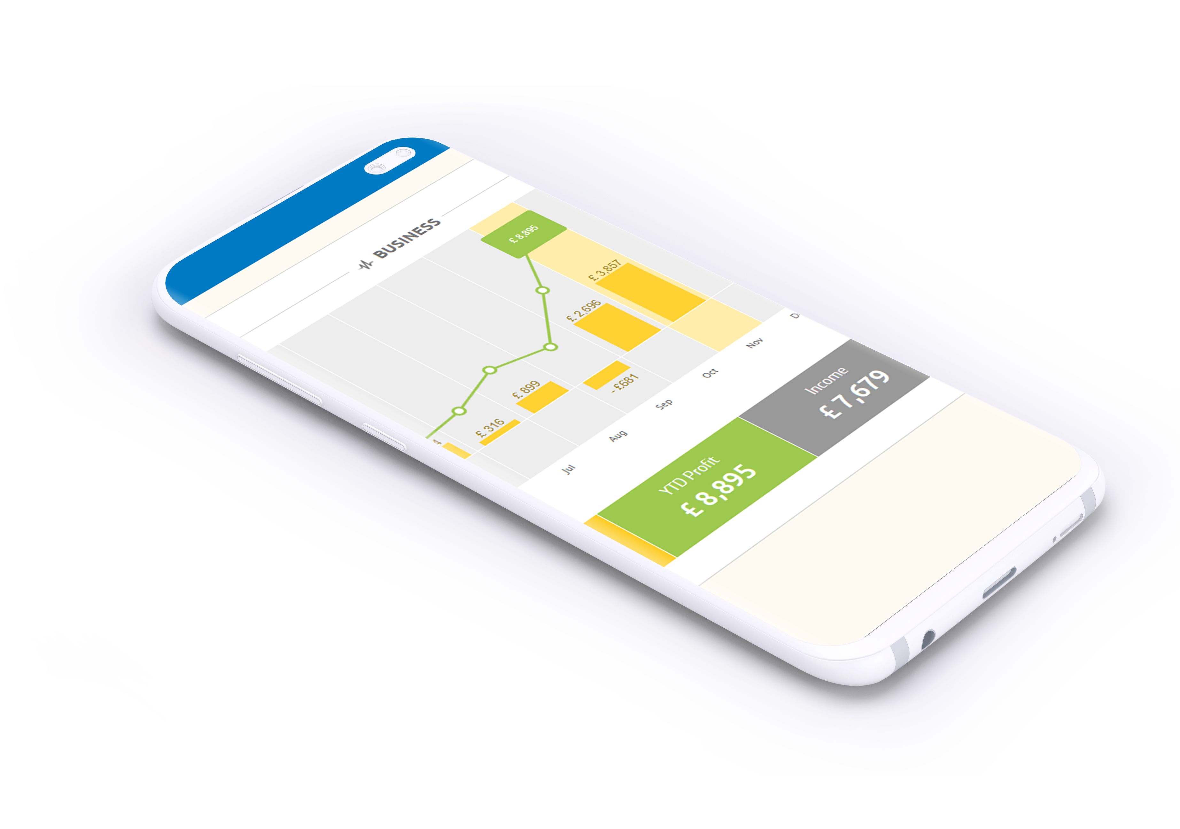
Let’s see finsit in action

Slide 6
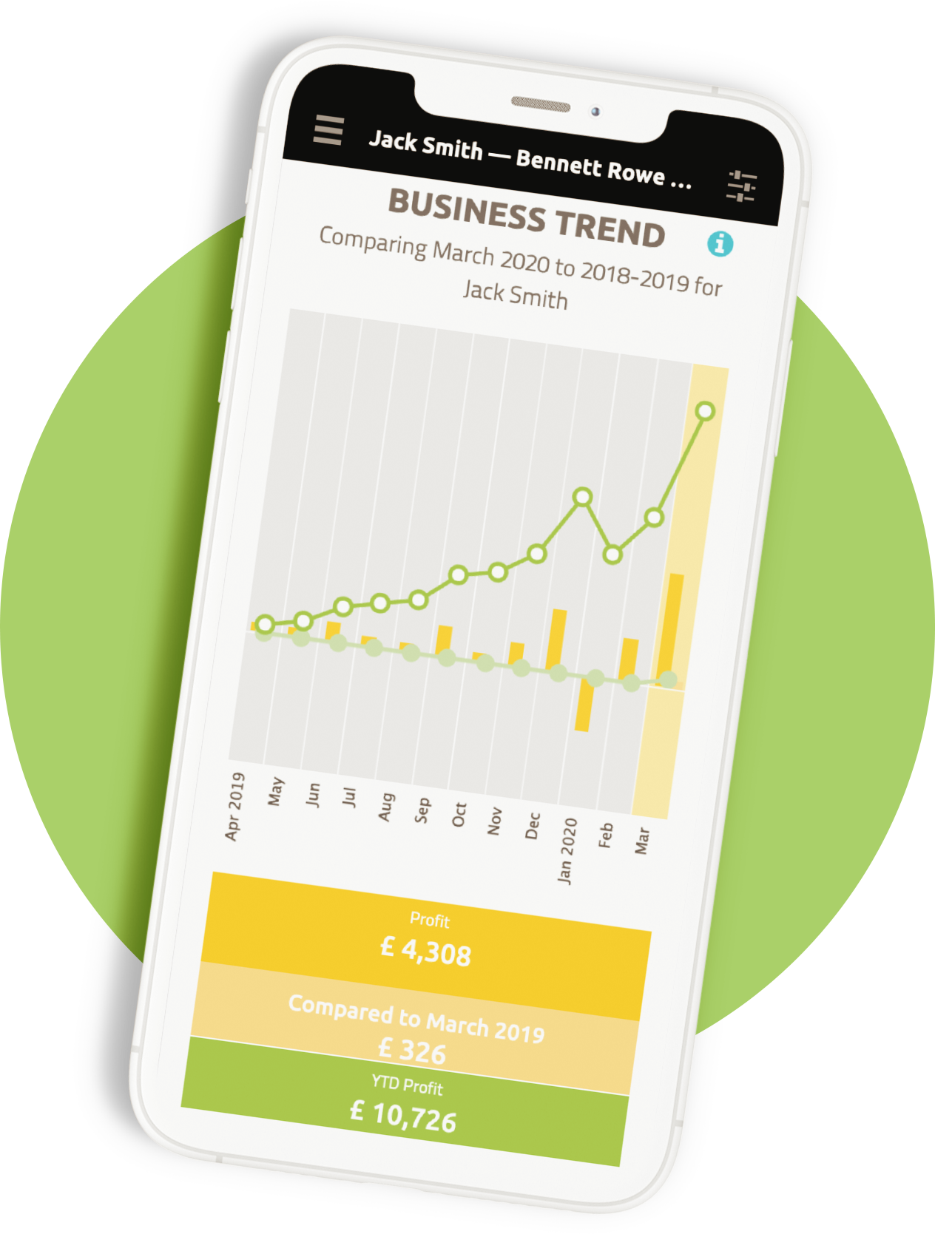
Congratulations, you’ve already done the hard part! ​
Data is at your disposal ​
Very few steps needed to create a new revenue stream​
No long-winded configurations and certifications ​
More functionality in development as we speak​
Any more questions? Email us at uk-digitalteam@wolterskluwer.com

Slide 7

Your questions

Slide 8
Stay connected with us
wolterskluwer.com
@wolterskluweruk
linkedin.com/company/
wolterskluweruk

